Slide 1
Process Scheduling

Slide 2
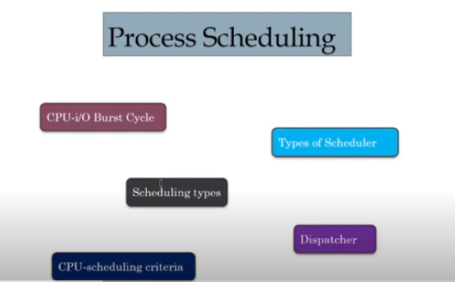

Slide 3
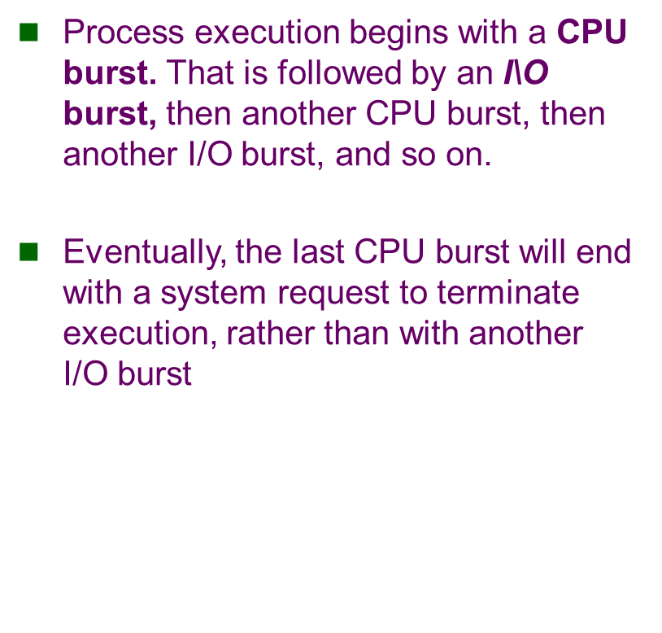

Slide 4
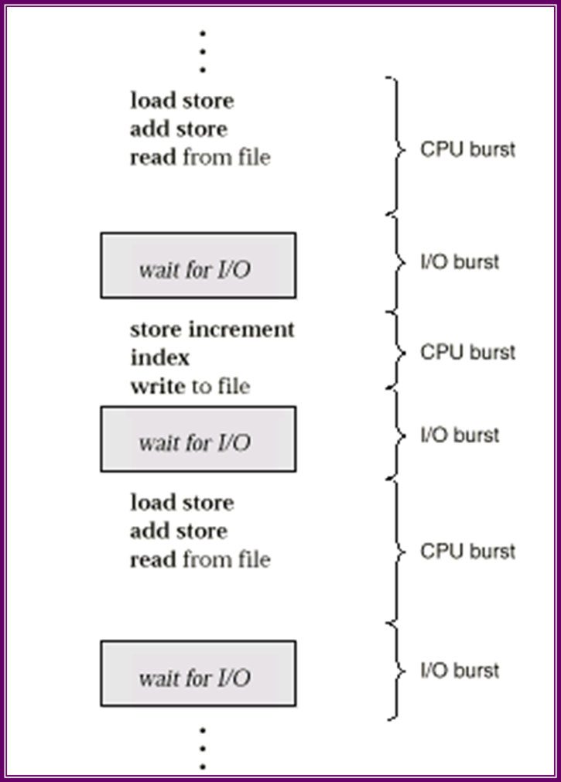

Slide 5
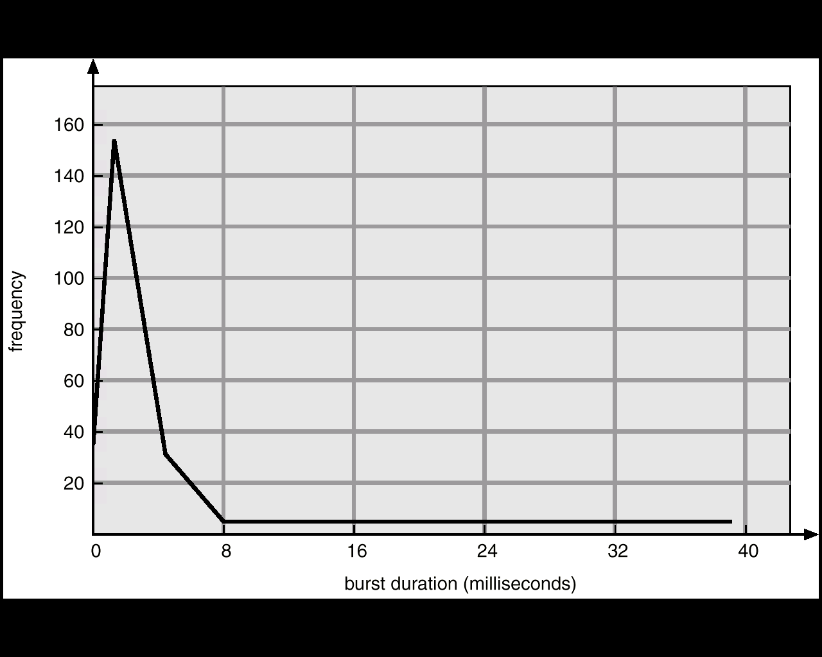
Histogram of CPU-burst Times
many short CPU bursts, and a few long CPU bursts.
An I/O-bound program would typically have many very short CPU bursts. A CPU-bound program might have a few very long CPU bursts.

Slide 6
Process Schedulers
A scheduler is a decision maker that selects the processes from one scheduling queue to another or allocates CPU for execution. The Operating System has three types of scheduler:
1. Long-term scheduler or Job scheduler
2. Short-term scheduler or CPU scheduler
3. Medium-term scheduler

Slide 7
1 Long-term scheduler or Job scheduler
The long-term scheduler or job scheduler selects processes from discs and loads them into main memory for execution. It executes much less frequently.
It controls the degree of multiprogramming (i.e., the number of processes in memory).
Because of the longer interval between executions, the long-term scheduler can afford to take more time to select a process for execution.
I/O-bound process – spends more time doing I/O than computations, many short CPU bursts.
CPU-bound process – spends more time doing computations; few very long CPU bursts.

Slide 8
2. Short-term scheduler or CPU scheduler/Dispatcher scheduler
The short-term scheduler or CPU scheduler selects a process from among the processes that are ready to execute and allocates the CPU.
The short-term scheduler must select a new process for the CPU frequently. A process may execute for only a few milliseconds before waiting for an I/O request.

Slide 9
3. Medium-term scheduler
The medium-term scheduler is basically used in time sharing operating system.
When process expired its time slice(i.e. quantum) it will swapped out from CPU & put it into partially executed queue. & again swap in into ready queue for the execution.

Slide 10
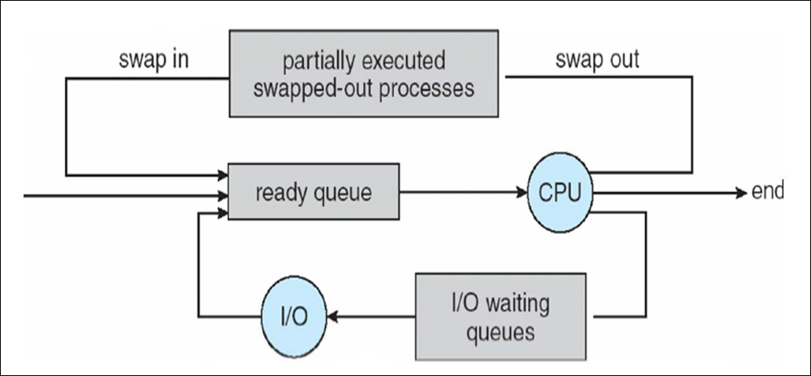
Medium-term scheduler

Slide 11
Comparison Between scheduler
S.N. | Long-Term Scheduler | Short-Term Scheduler | Medium-Term Scheduler
1 | It is a job scheduler | It is a CPU scheduler | It is a process swapping scheduler.
2 | Speed is lesser than short term scheduler | Speed is fastest among other two | Speed is in between both short and long term scheduler.
3 | It controls the degree of multiprogramming | It provides lesser control over degree of multiprogramming | It reduces the degree of multiprogramming.
4 | It is almost absent or minimal in time sharing system | It is also minimal in time sharing system | It is a part of Time sharing systems.
5 | It selects processes from pool and loads them into memory for execution | It selects those processes which are ready to execute | It can re-introduce the process into memory and execution can be continued.

Slide 12
Dispatcher
Dispatcher module gives control of the CPU to the process selected by the short-term scheduler; this involves:
switching context
switching to user mode
jumping to the proper location in the user program to restart that program
Dispatch latency – time it takes for the dispatcher to stop one process and start another running.

Slide 13
What is Process Scheduling?
The objective of multiprogramming is to have some process running at all times, to maximize CPU utilization
The objective of time sharing is to switch the CPU among processes so frequently that users can interact with each program while it is running.
To meet these objectives ,the process scheduler selects an available process(possibly from a set of several available processes)for program execution on the CPU.
- for a single processor system ,there will never be more than one running process.
-If there are more processes, the rest will have to wait until the CPU is free and can be rescheduled.

Slide 14
Process Scheduling
The act of determining which process is in the ready state, and should be moved to the running state is known as Process Scheduling.
The prime aim of the process scheduling system is to keep the CPU busy all the time and to deliver minimum response time for all programs.

Slide 15
Process Scheduling Queues
The OS maintains all PCBs in Process Scheduling Queues.
The OS maintains a separate queue for each of the process states and PCBs of all processes in the same execution state are placed in the same queue.
When the state of a process is changed, its PCB is unlinked from its current queue and moved to its new state queue.

Slide 16
Process Scheduling Queues
Job Queue: This queue consists of all processes in the system; those processes are entered to the system as new processes.
Ready Queue: This queue consists of the processes that are residing in main memory and are ready and waiting to execute by CPU.
Device Queue: This queue consists of the processes that are waiting for a particular I/O device. Each device has its own device queue.

Slide 17
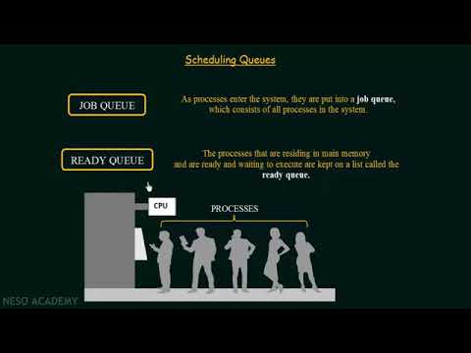

Slide 18
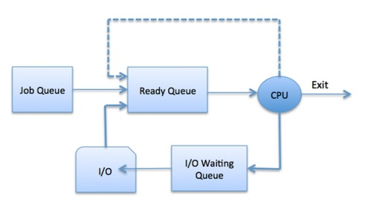

Slide 19
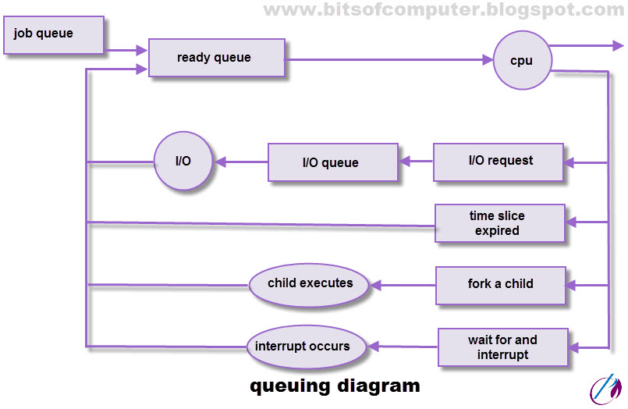

Slide 20
What is Context Switch?
Switching the CPU to another process requires saving the state of the old process and loading the saved state for the new process. This task is known as a Context Switch.
The context of a process is represented in the Process Control Block(PCB) of a process; it includes the value of the CPU registers, the process state and memory-management information. When a context switch occurs, the Kernel saves the context of the old process in its PCB and loads the saved context of the new process scheduled to run.
Context switch time is pure overhead, because the system does no useful work while switching. Its speed varies from machine to machine, depending on the memory speed, the number of registers that must be copied, and the existence of special instructions(such as a single instruction to load or store all registers). Typical speeds range from 1 to 1000 microseconds.
Context Switching has become such a performance bottleneck that programmers are using new structures(threads) to avoid it whenever and wherever possible.

Slide 21
Scheduling Criteria
Scheduling criteria are the set of parameters that are used to judge different CPU scheduling algorithms.
There are many different criteria's to check when considering the "best" scheduling algorithm.
Turnaround Time
It is the amount of time taken to execute a particular process, i.e. The interval from time of submission of the process to the time of completion of the process(Wall clock time).
Waiting Time
The sum of the periods spent waiting in the ready queue amount of time a process has been waiting in the ready queue to acquire get control on the CPU.
Load Average
It is the average number of processes residing in the ready queue waiting for their turn to get into the CPU.

Slide 22
Scheduling Criteria
Response Time
Amount of time it takes from when a request was submitted until the first response is produced. Remember, it is the time till the first response and not the completion of process execution(final response).
In general CPU utilization and Throughput are maximized and other factors are reduced for proper optimization.

Slide 23
CPU Scheduler
Selects from among the processes in memory that are ready to execute, and allocates the CPU to one of them.
CPU scheduling decisions may take place when a process:
1.Switches from running to waiting state. (for example, I/O request, or invocation of wait for the termination of one of the child processes)
2. Switches from running to ready state. (for example, when an interrupt occurs)
3. Switches from waiting to ready. (for example, completion of I/O)
4. Terminates.
When scheduling takes place only under circumstances 1 and 4, we say the scheduling scheme is nonpreemptive; otherwise, the scheduling scheme is preemptive.
Under nonpreemptive scheduling, once the CPU has been allocated to a process, the process keeps the CPU until it releases the CPU either by terminating or by switching to the waiting state.

Slide 24
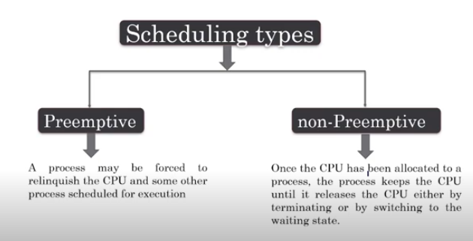

Slide 25
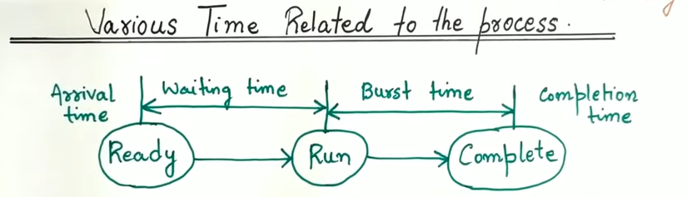

Slide 26
Criteria of CPU Scheduling
CPU scheduling criteria, such as turnaround time, waiting time, and throughput, are essential metrics used to evaluate the efficiency of scheduling algorithms.
1. CPU utilization
The main objective of any CPU scheduling algorithm is to keep the CPU as busy as possible. Theoretically, CPU utilization can range from 0 to 100 but in a real-time system, it varies from 40 to 90 percent depending on the load upon the system.
2. Throughput
A measure of the work done by the CPU is the number of processes being executed and completed per unit of time. This is called throughput. The throughput may vary depending on the length or duration of the processes.

Slide 27
3. Turnaround Time
For a particular process, an important criterion is how long it takes to execute that process. The time elapsed from the time of submission of a process to the time of completion is known as the turnaround time. Turn-around time is the sum of times spent waiting to get into memory, waiting in the ready queue, executing in CPU, and waiting for I/O.
Turn Around Time = Completion Time – Arrival Time

Slide 28
4. Waiting Time
A scheduling algorithm does not affect the time required to complete the process once it starts execution. It only affects the waiting time of a process i.e. time spent by a process waiting in the ready queue.
Waiting Time = Turnaround Time – Burst Time

Slide 29
5 Response Time
Amount of time it takes from when a request was submitted until the first response is produced. Remember, it is the time till the first response and not the completion of process execution(final response).
In general CPU utilization and Throughput are maximized and other factors are reduced for proper optimization.
Response Time = CPU Allocation Time(when the CPU was allocated for the first) – Arrival Time

Slide 30
6 Completion Time
The completion time is the time when the process stops executing, which means that the process has completed its burst time and is completely executed.

Slide 31
Scheduling Criteria
CPU utilization – keep the CPU as busy as possible
Throughput –number of processes that complete their execution per time unit
Turnaround time – amount of time to execute a particular process
Waiting time – amount of time a process has been waiting in the ready queue
Response time – amount of time it takes from when a request was submitted until the first response is produced. (a process can produce some output fairly early, and can continue computing new results while previous results are being output to the user.)

Slide 32
Optimization Criteria
Max CPU utilization
Max throughput
Min turnaround time
Min waiting time
Min response time

Slide 33
Types of CPU Scheduling
1. Non-Preemptive Scheduling: Process keeps CPU until completion.
2. Preemptive Scheduling: Process can be interrupted based on priority.

Slide 34
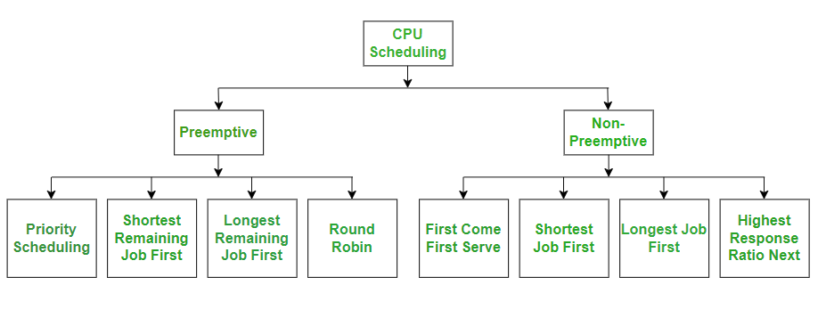
CPU Scheduling Algorithms

Slide 35
Scheduling Algorithms
1. First Come First Serve (FCFS)
2. Shortest Job First (SJF)
3. Priority Scheduling
4. Round Robin Scheduling
5. Shortest Remaining Time First(SRTF)

Slide 36
First Come First Serve Scheduling
The process which arrives first, gets executed first, or we can say that the process which requests the CPU first, gets the CPU allocated first.
First Come First Serve, is just like FIFO(First in First out) Queue data structure,
This is used in Batch Systems.
It's easy to understand and implement programmatically, using a Queue data structure, where a new process enters through the tail of the queue, and the scheduler selects process from the head of the queue.
A perfect real life example of FCFS scheduling is buying tickets at ticket counter.

Slide 37
First Come First Serve (FCFS)
Processes are scheduled in the order they arrive. Implemented using FIFO queue.
Turnaround Time = Completion Time - Arrival Time
Waiting Time = Turnaround Time - Burst Time

Slide 38

Example 1
S. No | Process ID | Arrival Time | Burst Time
1 | P 1 | 0 | 9
2 | P 2 | 1 | 3
3 | P 3 | 1 | 2
4 | P 4 | 1 | 4
5 | P 5 | 2 | 3
6 | P 6 | 3 | 2
Gantt chart for the above Example 1 is:

Slide 39
S. No | Process ID | Arrival Time | Burst Time | Completion Time | Turn Around Time | Waiting Time
1 | P 1 | 0 | 9
2 | P 2 | 1 | 3
3 | P 3 | 1 | 2
4 | P 4 | 1 | 4
5 | P 5 | 2 | 3
6 | P 6 | 3 | 2

Slide 40
S. No | Process ID | Arrival Time | Burst Time | Completion Time | Turn Around Time | Waiting Time
1 | P 1 | 0 | 9 | 9 | 9 | 0
2 | P 2 | 1 | 3 | 12 | 11 | 8
3 | P 3 | 1 | 2 | 14 | 13 | 11
4 | P 4 | 1 | 4 | 18 | 17 | 13
5 | P 5 | 2 | 3 | 21 | 19 | 16
6 | P 6 | 3 | 2 | 23 | 20 | 18

Slide 41
The Average Completion Time is:
Average CT = ( 9 + 12 + 14 + 18 + 21 + 23 ) / 6
Average CT = 97 / 6
Average CT = 16.16667
The Average Waiting Time is:
Average WT = ( 0 + 8 + 11 + 13 + 16 + 18 ) /6
Average WT = 66 / 6
Average WT = 11

Slide 42
Shortest Job First (SJF)
Characteristics of SJF Scheduling:
Shortest Job first has the advantage of having a minimum average waiting time among all scheduling algorithms.
It is a Greedy Algorithm.
This is the best approach to minimize waiting time.
This is used in Batch Systems.

Slide 43
Algorithm:
Sort all the processes according to the arrival time.
Then select that process that has minimum arrival time and minimum Burst time.
After completion of the process make a pool of processes that arrives afterward till the completion of the previous process and select that process among the pool which is having minimum Burst time.

Slide 44
Shortest Job First (SJF)
It may cause starvation if shorter processes keep coming. This problem can be solved using the concept of ageing.
It is practically infeasible as Operating System may not know burst times and therefore may not sort them. While it is not possible to predict execution time, several methods can be used to estimate the execution time for a job, such as a weighted average of previous execution times.
SJF can be used in specialized environments where accurate estimates of running time are available.

Slide 45
Shortest Job First (SJF)
Example
In the following example, there are five jobs named as P1, P2, P3, P4 and P5. Their arrival time and burst time are given in the table below.
PID | Arrival Time | Burst Time
1 | 1 | 7
2 | 3 | 3
3 | 6 | 2
4 | 7 | 10
5 | 9 | 8
So that's how the procedure will go on in shortest job first (SJF) scheduling algorithm.

Slide 46
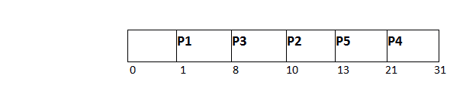
Since, No Process arrives at time 0 hence; there will be an empty slot in the Gantt chart from time 0 to 1 (the time at which the first process arrives).
According to the algorithm, the OS schedules the process which is having the lowest burst time among the available processes in the ready queue.
Till now, we have only one process in the ready queue hence the scheduler will schedule this to the processor no matter what is its burst time.
At Arrival Time | Queue Status
0 | Empty
1 | P1
8 | P2,P3,P4
10 | P2,P4,P5

Slide 47
This will be executed till 8 units of time. Till then we have three more processes arrived in the ready queue hence the scheduler will choose the process with the lowest burst time.
Among the processes given in the table, P3 will be executed next since it is having the lowest burst time among all the available processes.
So that's how the procedure will go on in shortest job first (SJF) scheduling algorithm.
Avg Waiting Time = 27/5=5.4
AVG TAT=11.4

Slide 48
PID | Arrival Time | Burst Time | Completion Time | Turn Around Time | Waiting Time
1 | 1 | 7 | 8 | 7 | 0
2 | 3 | 3 | 13 | 10 | 7
3 | 6 | 2 | 10 | 4 | 2
4 | 7 | 10 | 31 | 24 | 14
5 | 9 | 8 | 21 | 12 | 4

Slide 49
Example-2: Consider the following table of arrival time and burst time for five processes P1, P2, P3, P4 and P5.
Process | Burst Time | Arrival Time
P1 | 6 ms | 2 ms
P2 | 2 ms | 5 ms
P3 | 8 ms | 1 ms
P4 | 3 ms | 0 ms
P5 | 4 ms | 4 ms

Slide 50

P4 = 0 – 0 = 0
P1 = 3 – 2 = 1
P2 = 9 – 5 = 4
P5 = 11 – 4 = 7
P3 = 15 – 1 = 14
Average Waiting Time = 0 + 1 + 4 + 7 + 14/5 = 26/5 = 5.2

Slide 51
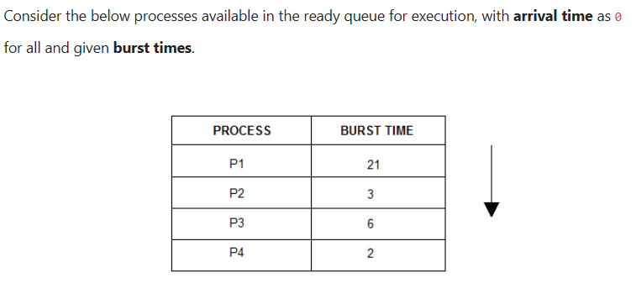

Slide 52
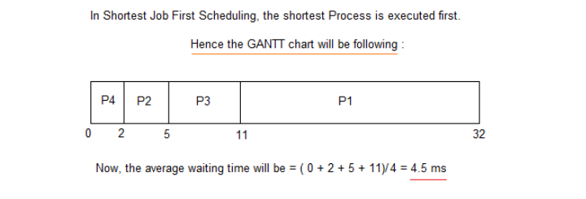

Slide 53
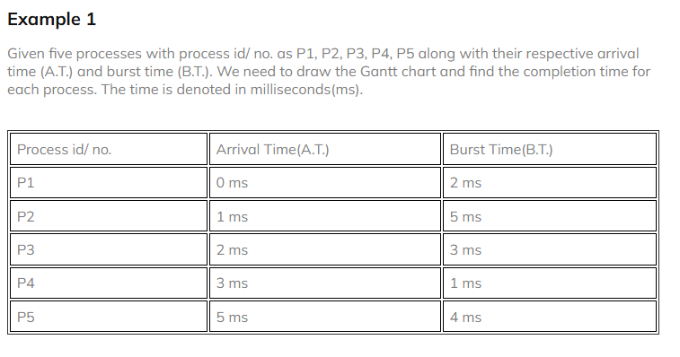

Slide 54

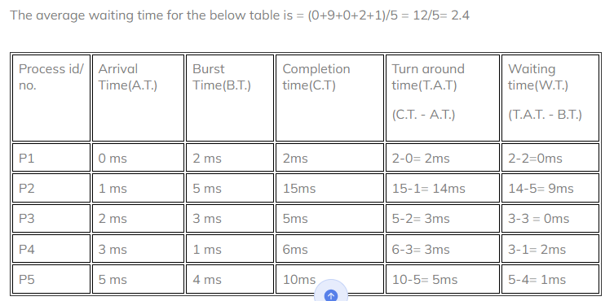

Slide 55
Priority Scheduling
Each process is assigned a priority. Higher priority processes are executed first.
Can be preemptive or non-preemptive.
Example: Priority-based execution order with average turnaround and waiting times.

Slide 56
Priority Scheduling
A CPU algorithm that schedules processes based on priority.
It used in Operating systems for performing batch processes.
If two jobs having the same priority are READY, it works on a FIRST COME, FIRST SERVED basis.
In priority scheduling, a number is assigned to each process that indicates its priority level.
Lower the number, higher is the priority.
In this type of scheduling algorithm, if a newer process arrives, that is having a higher priority than the currently running process, then the currently running process is preempted.

Slide 57
Example 1: Consider following five processes P1 to P5. Each process has its unique priority, burst time, and arrival time.
Process | Priority | Burst time | Arrival time
P1 | 1 | 4 | 0
P2 | 2 | 3 | 0
P3 | 1 | 7 | 6
P4 | 3 | 4 | 11
P5 | 2 | 2 | 12

Slide 58
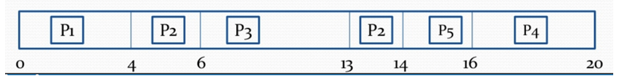
Waiting Time = start time – arrival time + wait time for next burst
P1 = 0 - 0 = 0
P2 =4 - 0 + 7 =11
P3= 6-6=0
P4= 16-11=5
P5=14-12=2
Average Waiting time = (0+11+0+5+2)/5 = 18/5= 3.6

Slide 59
Implementation
First input the processes with their arrival time, burst time and priority.
First process will schedule, which have the lowest arrival time, if two or more processes will have lowest arrival time, then whoever has higher priority will schedule first.
Now further processes will be schedule according to the arrival time and priority of the process. (lower the priority number having higher priority). If two process priority are same then sort according to process number.
Once all the processes have been arrived, schedule them based on their priority.

Slide 60
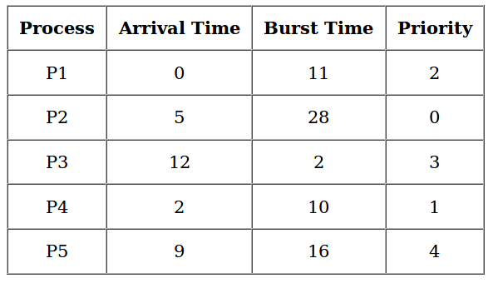
Example 1: Consider the set of 5 processes whose arrival time and burst time are given below (Lower the number higher priority) . Calculate ATAT and AWT using Non preemptive and Preemptive method.

Slide 61
Example 2: Consider the set of 5 processes whose arrival time and burst time are given below
Process Id | Arrival time | Burst time | Priority
P1 | 0 | 4 | 2
P2 | 1 | 3 | 3
P3 | 2 | 1 | 4
P4 | 3 | 5 | 5
P5 | 4 | 2 | 5

Slide 62

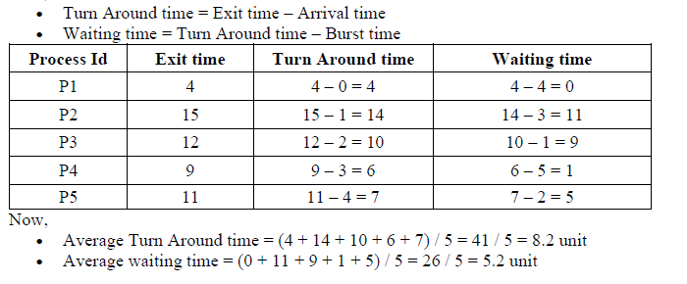

Slide 63
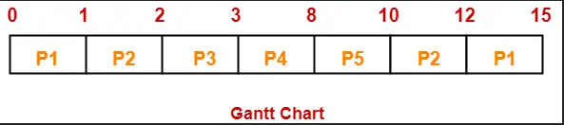
Process Id | Completion time | Turn Around time | Waiting time
P1 | 15 | 15 – 0 = 15 | 15 – 4 = 11
P2 | 12 | 12 – 1 = 11 | 11 – 3 = 8
P3 | 3 | 3 – 2 = 1 | 1 – 1 = 0
P4 | 8 | 8 – 3 = 5 | 5 – 5 = 0
P5 | 10 | 10 – 4 = 6 | 6 – 2 = 4
Average Turn Around time = (15 + 11 + 1 + 5 + 6) / 5 = 38 / 5 = 7.6 unit
Average waiting time = (11 + 8 + 0 + 0 + 4) / 5 = 23 / 5 = 4.6 unit

Slide 64
Priority Scheduling
Priority scheduling is a method of scheduling processes that is based on priority. In this algorithm, the scheduler selects the tasks to work as per the priority.
In Priority Preemptive Scheduling, the tasks are mostly assigned with their priorities.
In Priority Non-preemptive scheduling method, the CPU has been allocated to a specific process.
Processes are executed on the basis of priority so high priority does not need to wait for long which saves time
If high priority processes take lots of CPU time, then the lower priority processes may starve and will be postponed for an indefinite time.

Slide 65
Advantages of priority scheduling
Easy to use scheduling method
Processes are executed on the basis of priority so high priority does not need to wait for long which saves time
This method provides a good mechanism where the relative important of each process may be precisely defined.
Suitable for applications with fluctuating time and resource requirements.

Slide 66
Disadvantages of priority scheduling
If the system eventually crashes, all low priority processes get lost.
If high priority processes take lots of CPU time, then the lower priority processes may starve and will be postponed for an indefinite time.
This scheduling algorithm may leave some low priority processes waiting indefinitely.
A process will be blocked when it is ready to run but has to wait for the CPU because some other process is running currently.
If a new higher priority process keeps on coming in the ready queue, then the process which is in the waiting state may need to wait for a long duration of time.

Slide 67
Round Robin Scheduling
Round Robin(RR) scheduling algorithm is mainly designed for time-sharing systems.
This algorithm is similar to FCFS scheduling, but in Round Robin(RR) scheduling, preemption is added which enables the system to switch between processes.
A fixed time is allotted to each process, called a quantum, for execution.
Once a process is executed for the given time period that process is preempted and another process executes for the given time period.
Context switching is used to save states of preempted processes.
This algorithm is simple and easy to implement and the most important is thing is this algorithm is starvation-free as all processes get a fair share of CPU.
It is important to note here that the length of time quantum is generally from 10 to 100 milliseconds in length.

Slide 68
Round Robin (RR)
Each process gets a small unit of CPU time (time quantum), usually 10-100 milliseconds. After this time has elapsed, the process is preempted and added to the end of the ready queue.
If there are n processes in the ready queue and the time quantum is q, then each process gets 1/n of the CPU time in chunks of at most q time units at once. No process waits more than (n-1)q time units.
Performance
q large ⇒ FIFO
q small ⇒ q must be large with respect to context switch, otherwise overhead is too high.

Slide 69
Example -Assume Time Quantum TQ = 5
S. No Process ID Arrival Time Burst Time
_ _ _ _ _ _ _ _ _ _ _ _ _ _ _ _ _ _ _ _ _ _
1 P 1 0 7
2 P 2 1 4
3 P 3 2 15
4 P 4 3 11
5 P 5 4 20
6 P 6 4 9

Slide 70
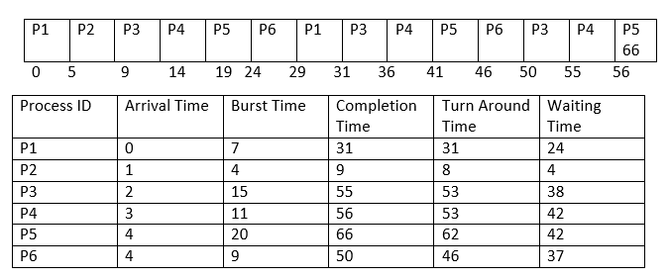
Gantt chart:

Slide 71
Average Completion Time
Average Completion Time = ( 31 +9 + 55 +56 +66 + 50 ) / 6
Average Completion Time = 267 / 6
Average Completion Time = 44.5
Average Waiting Time
Average Waiting Time = ( 5 + 26 + 5 + 42 + 42 + 37 ) / 6
Average Waiting Time = 157 / 6
Average Waiting Time = 26.16667
Average Turn Around Time
Average Turn Around Time = ( 31 + 8 + 53 + 53 + 62 + 46 ) / 6
Average Turn Around Time = 253 / 6
Average Turn Around Time = 42.16667

Slide 72
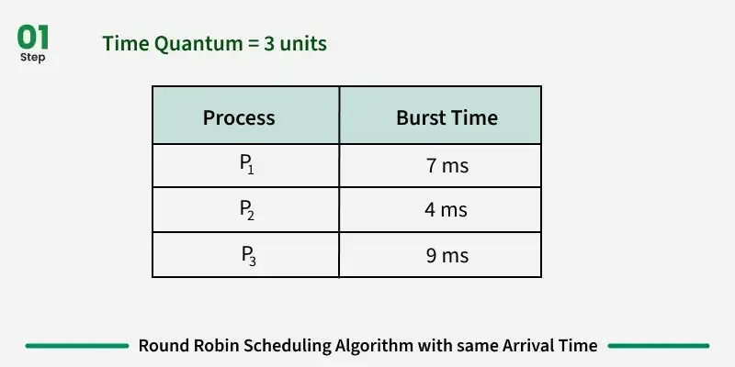
Example 2

Slide 73
PN BT WT TAT
1 10 13 23
2 5 9 14
3 8 14 21
Average waiting time = 12
Average turn around time = 19.6667

Slide 74
Example of RR with Time Quantum = 20
Process Burst Time
P₁ 53
P₂ 17
P₃ 68
P₄ 24
The Gantt chart is:
Typically, higher average turnaround than SJF, but better response.
P₁
P₂
P₃
P₄
P₁
P₃
P₄
P₁
P₃
P₃
0
20
37
57
77
97
117
121
134
154
162

Slide 75
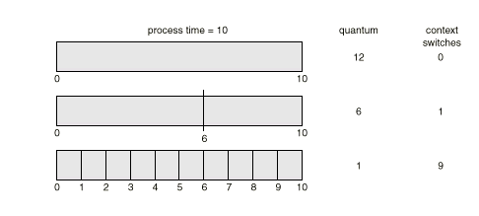
Time Quantum and Context Switch Time

Slide 76
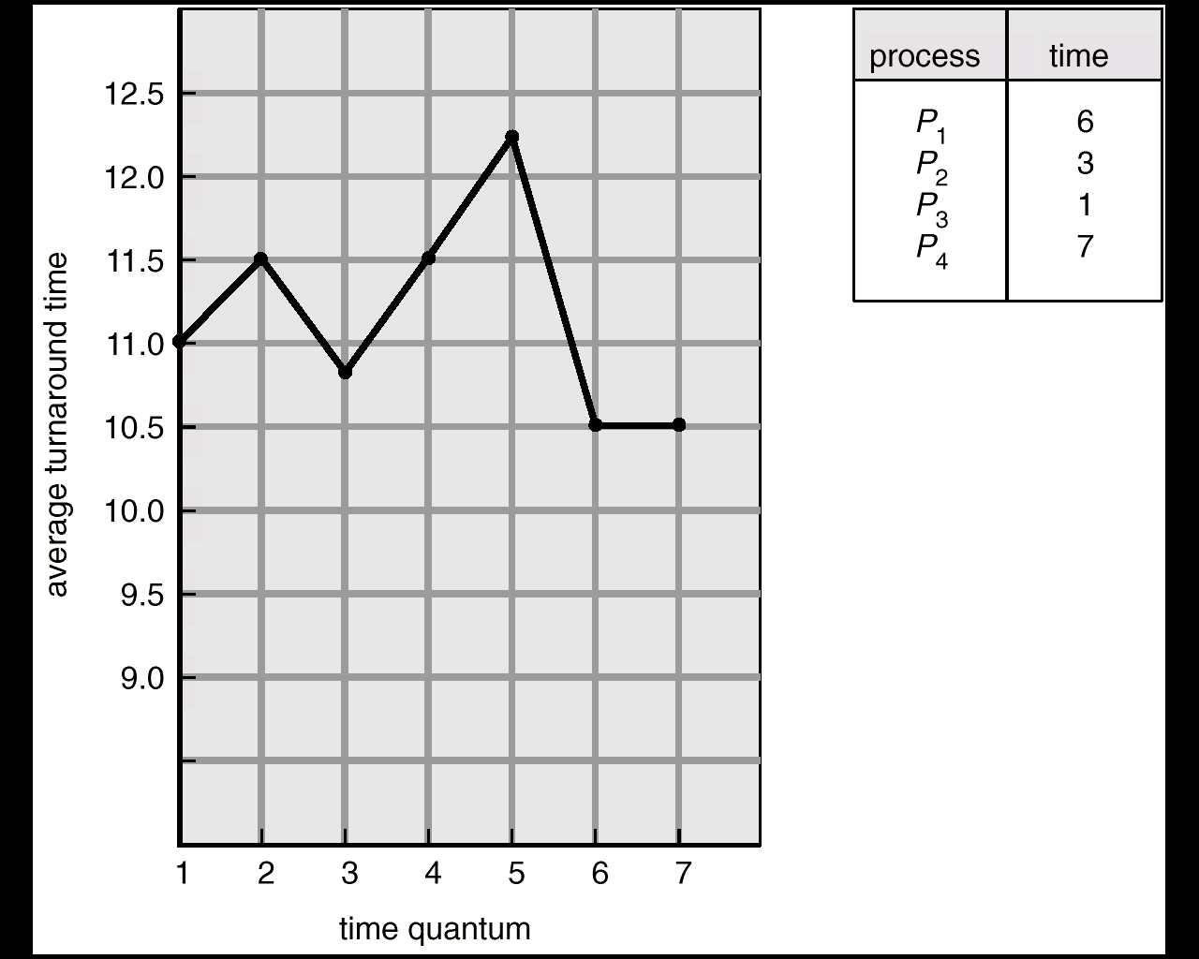
Turnaround Time Varies With The Time Quantum

Slide 77
Characteristics of the Round Robin(RR) Algorithm
Equal Time Allocation: Each process gets an equal and fixed time slice (time quantum) to execute, ensuring fairness.
Cyclic Execution: Processes are scheduled in a circular order, and the CPU moves to the next process in the queue after completing the time quantum.
No Process Starvation: All processes are guaranteed CPU time at regular intervals, preventing any process from being neglected.
Same Start Time: Since all processes arrive at the same time, there is no need to consider arrival time while scheduling, simplifying the process.
Context Switching: Frequent context switching occurs as the CPU moves between processes after each time quantum, which can slightly impact performance.

Slide 78
Advantages of Round Robin Scheduling Algorithm
While performing this scheduling algorithm, a particular time quantum is allocated to different jobs.
In terms of average response time, this algorithm gives the best performance.
With the help of this algorithm, all the jobs get a fair allocation of CPU.
In this algorithm, there are no issues of starvation or convoy effect.
This algorithm deals with all processes without any priority.
This algorithm is cyclic in nature.
In this, the newly created process is added to the end of the ready queue.
Also, in this, a round-robin scheduler generally employs time-sharing which means providing each job a time slot or quantum.
In this scheduling algorithm, each process gets a chance to reschedule after a particular quantum time.

Slide 79
Disadvantages
This algorithm spends more time on context switches.
For small quantum, it is time-consuming scheduling.
This algorithm offers a larger waiting time and response time.
In this, there is low throughput.
If time quantum is less for scheduling then its Gantt chart seems to be too big.

Slide 80
Shortest Remaining Time First (SRTF)
This Algorithm is the preemptive version of SJF scheduling.
In SRTF, the execution of the process can be stopped after certain amount of time.
At the arrival of every process, the short term scheduler schedules the process with the least remaining burst time among the list of available processes and the running process.
Once all the processes are available in the ready queue, No preemption will be done and the algorithm will work as SJF scheduling.
The context of the process is saved in the Process Control Block when the process is removed from the execution and the next process is scheduled. This PCB is accessed on the next execution of this process.

Slide 81
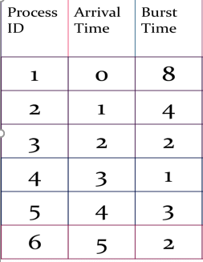
Example

Slide 82
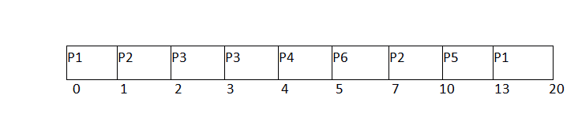
Gantt Chart

Slide 83
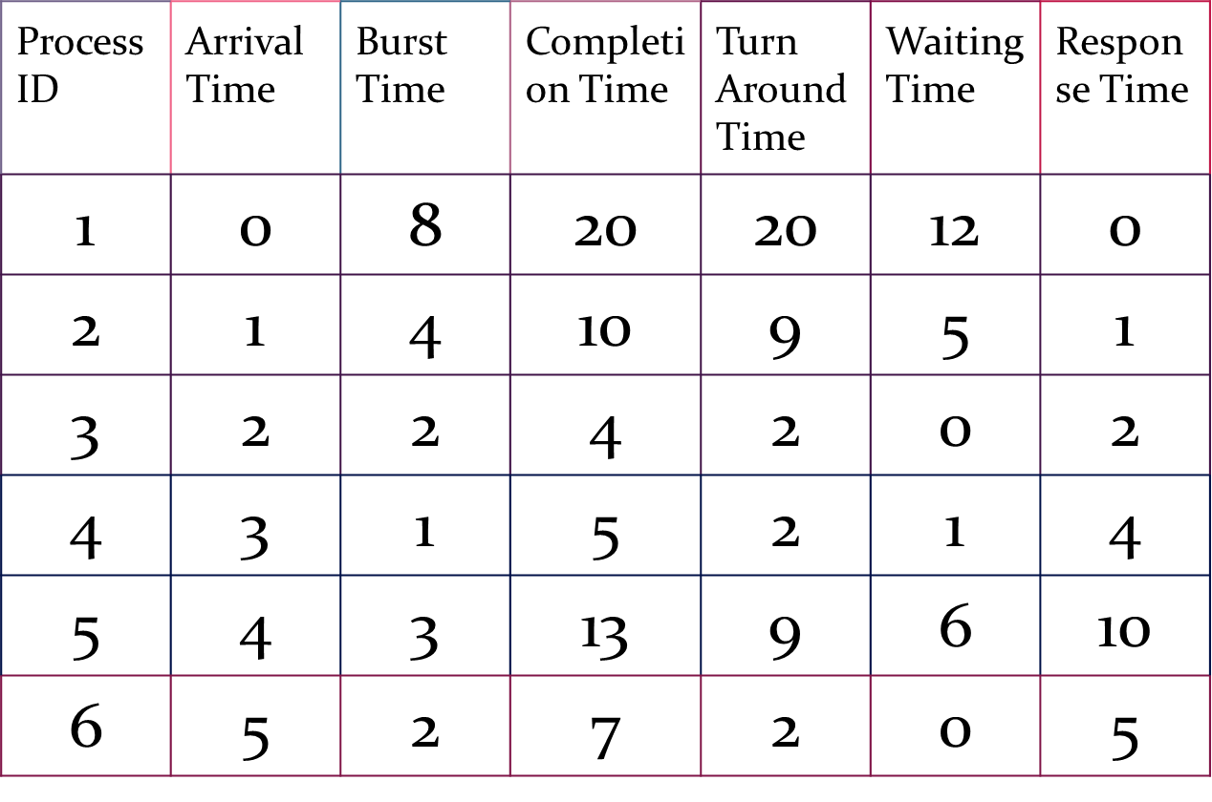
Avg Waiting Time = 24/6=4ms

Slide 84
Multilevel Queue
Ready queue is partitioned into separate queues: foreground (interactive) background (batch)
Each queue has its own scheduling algorithm, foreground – RR background – FCFS
Scheduling must be done between the queues.
Fixed priority scheduling; (i.e., serve all from foreground then from background). Possibility of starvation.
Time slice – each queue gets a certain amount of CPU time which it can schedule amongst its processes; i.e., 80% to foreground in RR 20% to background in FCFS

Slide 85
Let us look at an example of a multilevel queue-scheduling algorithm with five queues:
1. System processes
2. Interactive processes
3. Interactive editing processes
4. Batch processes
5. Student processes
Each queue has absolute priority over lower-priority queues. No process in the batch queue, for example, could run unless the queues for system processes, interactive processes, and interactive editing processes were all empty.
If an interactive editing process entered the ready queue while a batch process was running, the batch process would be preempted. Solaris 2 uses a form of this algorithm.

Slide 86
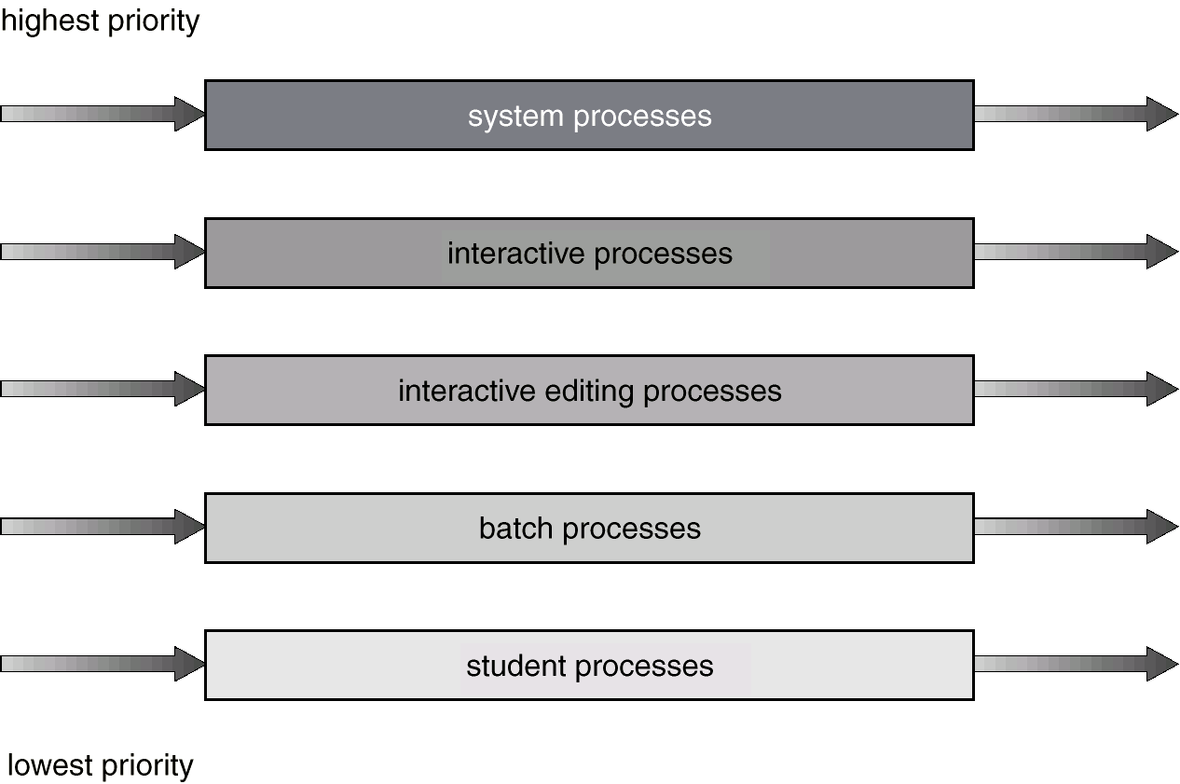
Multilevel Queue Scheduling

Slide 87
Multilevel Feedback Queue
A process can move between the various queues; aging can be implemented this way.
Multilevel-feedback-queue scheduler defined by the following parameters:
number of queues
scheduling algorithms for each queue
method used to determine when to upgrade a process
method used to determine when to demote a process
method used to determine which queue a process will enter when that process needs service

Slide 88
Example of Multilevel Feedback Queue
For example, consider a multilevel feedback queue scheduler with three queues, numbered from 0 to 2 (Figure 6.7). The scheduler first executes all processes in queue 0. Only when queue 0 is empty will it execute processes in queue 1. Similarly, processes in queue 2 will be executed only if queues 0 and 1 are empty. A process that arrives for queue 1 will preempt a process in queue 2. A process that arrives for queue 0 will, in turn, preempt a process in queue 1.
A process entering the ready queue is put in queue 0. A process in queue 0 is given a time quantum of 8 milliseconds. If it does not finish within this time, it is moved to the tail of queue 1. If queue 0 is empty, the process at the head of queue 1 is given a quantum of 16 milliseconds. If it does not complete, it is preempted and is put into queue 2. Processes in queue 2 are run on an FCFS basis, only when queues 0 and 1 are empty.

Slide 89
Example of Multilevel Feedback Queue
This scheduling algorithm gives highest priority to any process with a CPU burst of 8 milliseconds or less. Such a process will quickly get the CPU, finish its CPU burst, and go off to its next I/O burst. Processes that need more than 8, but less than 16, milliseconds are also served quickly, although with lower priority than shorter processes. Long processes automatically sink to queue 2 and are served in FCFS order with any CPU cycles left over from queues 0 and 1.

Slide 90
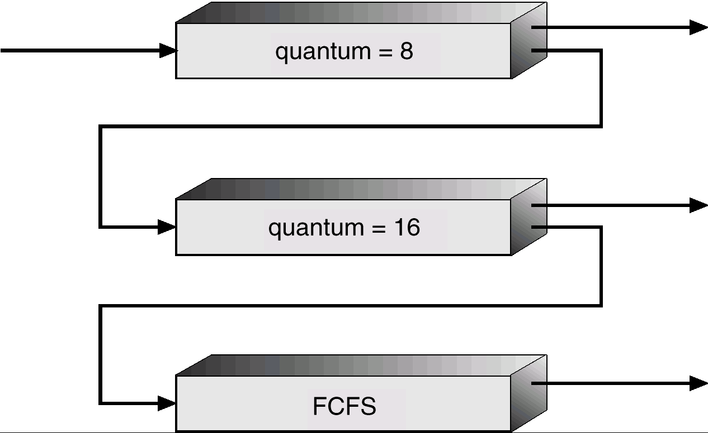
Figure 6.7

Slide 91
Multiple-Processor Scheduling
CPU scheduling more complex when multiple CPUs are available.
Homogeneous processors within a multiprocessor: We concentrate on systems where the processors are identical (or homogeneous) in terms of their functionality; any available processor can then be used to run any processes in the queue.
Load sharing : If several identical processors are available, then load sharing can occur. It would be possible to provide a separate queue for each processor. In this case, however, one processor could be idle, with an empty queue, while another processor was very busy. To prevent this situation, we use a common ready queue. All processes go into one queue and are scheduled onto any available processor.
Asymmetric multiprocessing – only one processor accesses the system data structures, alleviating the need for data sharing. having all scheduling decisions, I/O processing, and other system activities handled by one single processor-the master server. The other processors only execute user code.

Slide 92
Real-Time Scheduling
Hard real-time systems – required to complete a critical task within a guaranteed amount of time.
Soft real-time computing – requires that critical processes receive priority over less fortunate(أقل حظا) ones.

Slide 93
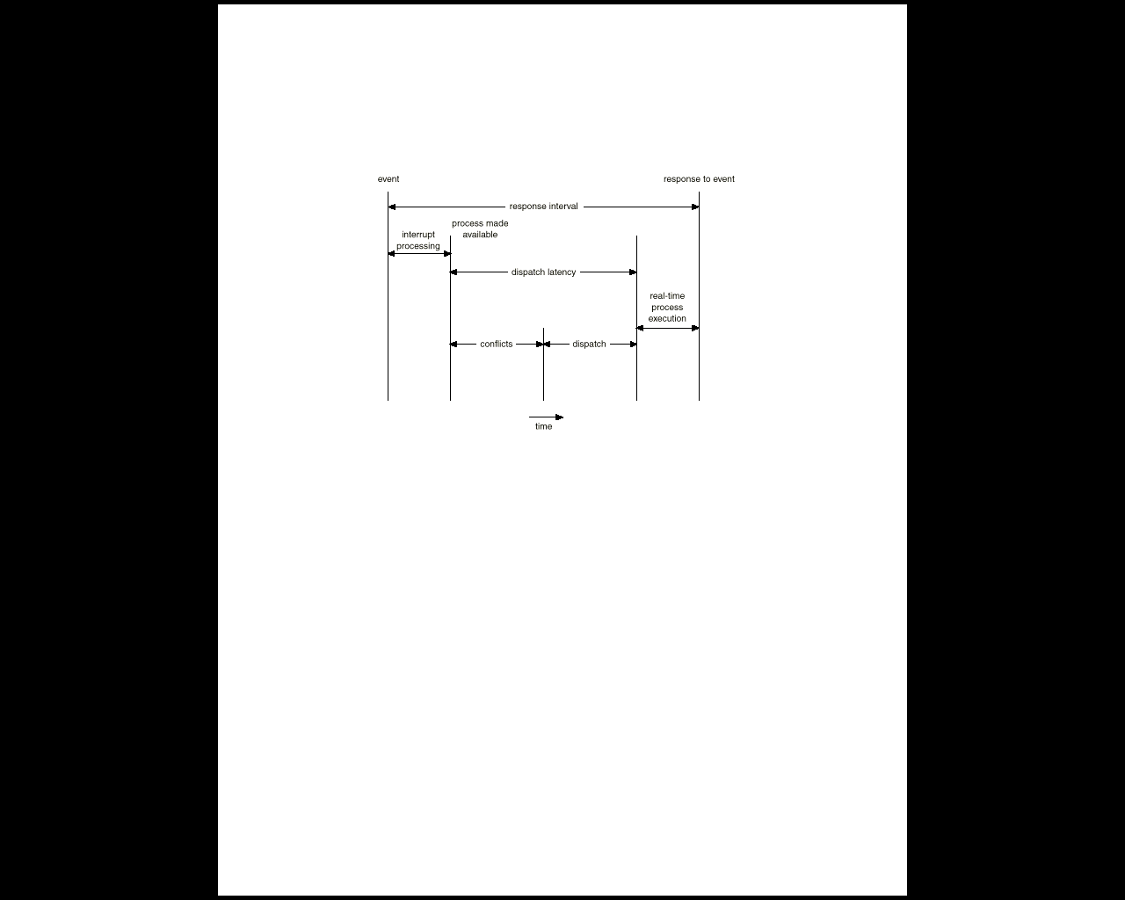
Dispatch Latency
Dispatch latency – time it takes for the dispatcher to stop one process and start another running.
The conflict phase of dispatch latency has two components:
1. Preemption of any process running in the kernel
2. Release by low-priority processes resources needed by the high-priority process

Slide 94
Algorithm Evaluation
How do we select a CPU-scheduling algorithm for a particular system? .
The first problem is defining the criteria to be used in selecting an algorithm. Criteria are often defined in terms of CPU utilization, response time, or throughput.
To select an algorithm, we must first define the relative importance of these measures. Our criteria may include several measures, such as:
Maximize CPU utilization under the constraint that the maximum response time is 1 second.
Maximize throughput such that turnaround time is (on average) linearly proportional to total execution time.
Once the selection criteria have been defined, we want to evaluate the various algorithms under consideration.

Slide 95
What is Thread?
A thread, sometimes called a lightweight process (LWP), is a basic unit of CPU execution.
It is a sequence of instructions within a process
Multiple threads are created within process.
The multiple threads in a process allow multiple execution
It comprises a thread ID, a program counter, a register (Intermediate data)set, and a stack.
It shares with other threads belonging to the same process its code section, data section, and other operating-system resources, such as open files and signals.

Slide 96
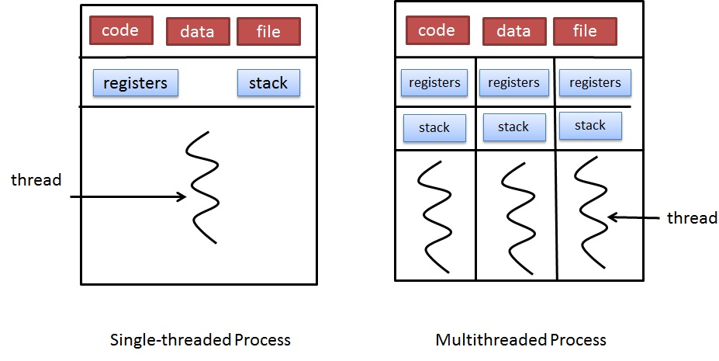
Single-threaded and multithreaded

Slide 97
Benefits Of Threads
It consumes less time to create and manage threads.
One thread can share the memory and other resources with another thread which belong to same process. That means, they can share the same address space.
It is more economic to create and context switch.
It increases the responsiveness of the user interactive applications.
It provides great utilization of multiprocessor architecture.
Use of multithreading on multi-CPU machine increases the concurrency.

Slide 98
Types of Thread
Threads are implemented in following two ways −
User Level Threads − User managed threads.
Kernel Level Threads − Operating System managed threads acting on kernel, an operating system core.
User Level Threads
In this case, the thread management kernel is not aware of the existence of threads. The thread library contains code for creating and destroying threads, for passing message and data between threads, for scheduling thread execution and for saving and restoring thread contexts. The application starts with a single thread.

Slide 99
User-Level Threads
User-level threads implement in user-level libraries, rather than via systems calls, so thread switching does not need to call operating system and to cause interrupt to the kernel. In fact, the kernel knows nothing about user-level threads and manages them as if they were single-threaded processes.
Advantages:
User-level threads do not require modification to operating systems.
Simple Representation: Each thread is represented simply by a PC, registers, stack and a small control block, all stored in the user process address space.
Simple Management: This simply means that creating a thread, switching between threads and synchronization between threads can all be done without intervention of the kernel.
Fast and Efficient: Thread switching is not much more expensive than a procedure call.
Disadvantages:
There is a lack of coordination between threads and operating system kernel.
User-level threads require non-blocking systems call i.e., a multithreaded kernel.

Slide 100
Kernel-Level Threads
In this method, the kernel knows about and manages the threads. Instead of thread table in each process, the kernel has a thread table that keeps track of all threads in the system. Operating Systems kernel provides system call to create and manage threads.
Advantages:
Because kernel has full knowledge of all threads, Scheduler may decide to give more time to a process having large number of threads than process having small number of threads.
Kernel-level threads are especially good for applications that frequently block.
Disadvantages:
The kernel-level threads are slow and inefficient. For instance, threads operations are hundreds of times slower than that of user-level threads.
Since kernel must manage and schedule threads as well as processes. It require a full thread control block (TCB) for each thread to maintain information about threads. As a result there is significant overhead and increased in kernel complexity.

Slide 101
Multithreading Models
Some operating system provide a combined user level thread and Kernel level thread facility. Solaris is a good example of this combined approach. In a combined system, multiple threads within the same application can run in parallel on multiple processors and a blocking system call need not block the entire process. Multithreading models are three types
Many to many relationship.
Many to one relationship.
One to one relationship

Slide 102
Many-to-One Model
The many-to-one model maps many user-level threads to one kernel thread. Thread management is done in user space, so it is efficient, but the entire process will block if a thread makes a blocking system call. Also, because only one thread can access the kernel at a time, multiple threads are unable to run in parallel on multiprocessors.

Slide 103
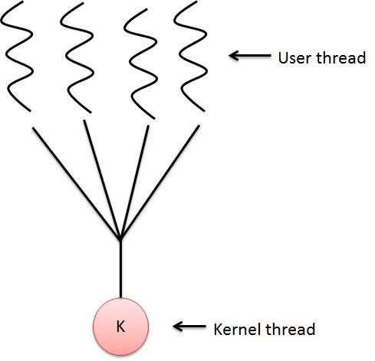

Slide 104
One to One Model
There is one-to-one relationship of user-level thread to the kernel-level thread. This model provides more concurrency than the many-to-one model. It also allows another thread to run when a thread makes a blocking system call. It supports multiple threads to execute in parallel on microprocessors.
Disadvantage of this model is that creating user thread requires the corresponding Kernel thread. OS/2, windows NT and windows 2000 use one to one relationship model.

Slide 105
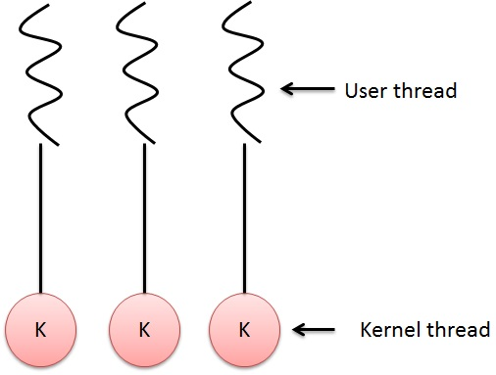

Slide 106
Many to Many Model
The many-to-many model multiplexes any number of user threads onto an equal or smaller number of kernel threads.
The following diagram shows the many-to-many threading model where 6 user level threads are multiplexing with 6 kernel level threads. In this model, developers can create as many user threads as necessary and the corresponding Kernel threads can run in parallel on a multiprocessor machine. This model provides the best accuracy on concurrency and when a thread performs a blocking system call, the kernel can schedule another thread for execution.

Slide 107
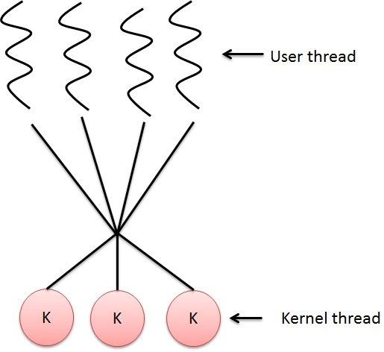

Slide 108
Difference between Threads

Slide 109
Difference

Slide 110
Multiprocessing scheduling
In the multiprocessor scheduling, there are multiple CPU’s which share the load so that various process run simultaneously. In general, the multiprocessor scheduling is complex as compared to single processor scheduling. In the multiprocessor scheduling, there are many processors and they are identical and we can run any process at any time.
The multiple CPU’s in the system are in the close communication which shares a common bus, memory and other peripheral devices.

Slide 111
Multiprocessing scheduling
A multiprocessor system consists of several processors which share memory.
In the multiprocessor, there is more than one processor in the system.
The reason we use multiprocessor is that sometimes load on the processor is very high but input output on other function is not required.
This type of operating system is more reliable as even if on processor goes down the other can still continues to work..

